Slide 1


Slide 2


4 / 12
Foundational Concepts - II
By : Mr. Shivam Supekar

Slide 3

Agenda
1
Union /Union All
2
Manipulating the data
3
Other important Functions

Slide 4
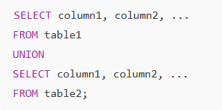
Union /Union All
What is UNION?
UNION combines the results of two or more SELECT queries into a single result set.
By default, it removes duplicate rows.
The queries being combined must have:
Same number of columns.
Same or compatible data types.
Same column order.

Slide 5
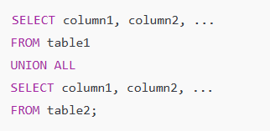
Union /Union All
What is UNION ALL?
UNION ALL also combines results of two or more queries.
Unlike UNION, it does not remove duplicates.
Hence, it is faster because SQL Server does not need to check for duplicates.

Slide 6



MANIPULATING THE DATA
Functions | Explanation
UPPER() | Converts text to uppercase
LOWER() | Converts text to lowercase.
LEN() | Returns the length of a string (number of characters).

Slide 7



MANIPULATING THE DATA
Functions | Explanation
SUBSTRING() | Extracts a part of a string.
REPLACE() | Replaces all occurrences of a substring with another
CONCAT() | Joins (concatenates) multiple strings into one.

Slide 8


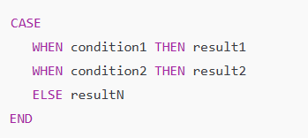
Other Important Functions
Functions | Explanation
CAST | Used to convert a value from one data type to another.
CONVERT | Also used to convert data types, but more flexible for dates and formatting.
CASE | Works like an IF-ELSE in SQL. Returns values based on conditions.

Slide 9
Q&A

